Slide 1
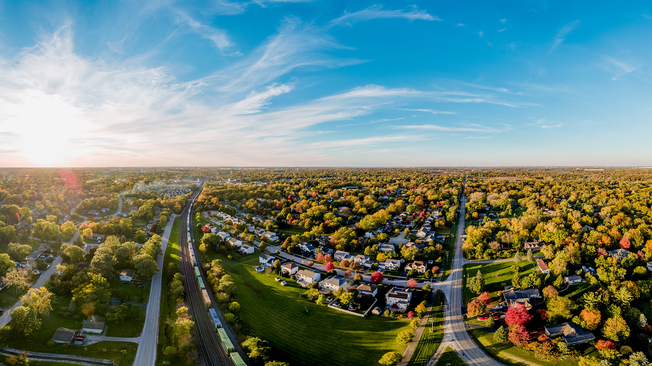

West Chicago
FY 27 Water/Sewer Workshop
Water and Sewer FUNDS

Slide 2

Fund Background

Slide 3
Water Infrastructure at a glance
~147 miles of distribution network (includes ~8 miles of raw watermain)
9 MG Water Treatment Plant
4 Shallow Silurian Dolomite Wells (~325 feet)
2 Elevated Water Towers - Hawthorne Lane (500,000 Gallons) & Fremont St (250,000 Gallons)
~2,500 Valves, ~2,000 FHs & ~7,100 water meters & services
~797 Lead Service Lines (LSL)
2 Booster Stations (Bishop St & Helena Dr) including one 500,000 Gallons Above Ground Storage at each location
5 Deep Sandstone Wells (~1,390 feet)

Slide 4
Sewer Infrastructure at a glance
~106 miles of sanitary collection system
7.4 MG Regional WCWWA WWTP
13 Sanitary Lift Stations
~1,500 Sanitary Manholes
~6,500 sanitary services

Slide 5
Aging & Inadequate Infrastructure
35% of the water distribution pipes are over 50 years old (~51.4 miles)
Wastewater Treatment Plant is 43 years old
Oldest water meters are ~16 years old; typical life expectancy of ~15-20 years
Storage Shortfall: 1.75 MG available vs. 4.5 MG recommended in 2011 Study
27% of the water distribution pipes are undersized (<6"), limiting flow and fire protection (~37.5 miles)

Slide 6
Aging & Inadequate Infrastructure
Hawthorne Tower (1967) & Fremont Tower (1959)
9 Wells, average age 37.3 years
13 Sanitary Lift Stations, average age 38.2 years
Water Treatment Plant-21 years old

Slide 7
Revenue & Expenses

Slide 8
FY 27 – 31 Water Estimated
Revenue vs. Expenses
Revenues*
Expenses
Water Service Charges - $46,368,600
IEPA SRF Loan - $20,832,600
Grants - $240,300
Total = $67,441,500
Operations (Distribution) - $21,859,120
Operations (Production)- $14,571,245
Capital (Distribution)-$33,093,400**
Capital (Production)- $3,572,500
Transfers Out - $1,071,500
Total = $74,167,765
Revenues:
Expenses:
Total =
$67,441,500
$74,167,765
-$6,726,265
*Pre-planned 2027 and 2028 rate increases not included
** Includes Debt Service for LSLR ($1,292,700) & 1.5 MG Water Tower ($1,545,300)

Slide 9
FY 27 – 31 Water Estimated
Revenue vs. Expenses

Slide 10
FY 27 – 31 Estimated Sewer
Revenue vs. Expenses
Revenue*
expenses
Sewer Charges - $40,808,300
Grants - $210,100
Transfers In - $1,800,000**
Total = $42,818,400
Operations (Sewer) - $39,398,105
Capital (Sewer) - $12,324,300
Transfers Out - $131,700
Total = $51,854,105
Revenues:
Expenses:
Total =
$42,818,400
$51,854,105
-$9,035,705
*Pre-planned 2027 and 2028 rate increases not included
** Includes 50% of the 0.25% HRST increase (effective 1/1/27) from 2027-2029

Slide 11
FY 27 – 31 Estimated Sewer
Revenue vs. Expenses

Slide 12
Water CIP Program
Five Year outlook

Slide 13
Project Determination
Grant Funding Deadlines
Pavement Reconstruction/Resurfacing
Sanitary Sewer Evaluation Survey
Watermain Break History
Age of Underground Infrastructure
Public Safety: LSLR
Unfunded Mandates: LSLR, Phosphorus Limits, etc.
2026 WWTP Condition Assessment (~$21 Million in CIP between 2027-36)
2024 WTP Condition Assessment Study (~$20.6 Million in CIP over 20-years starting in 2025)

Slide 14
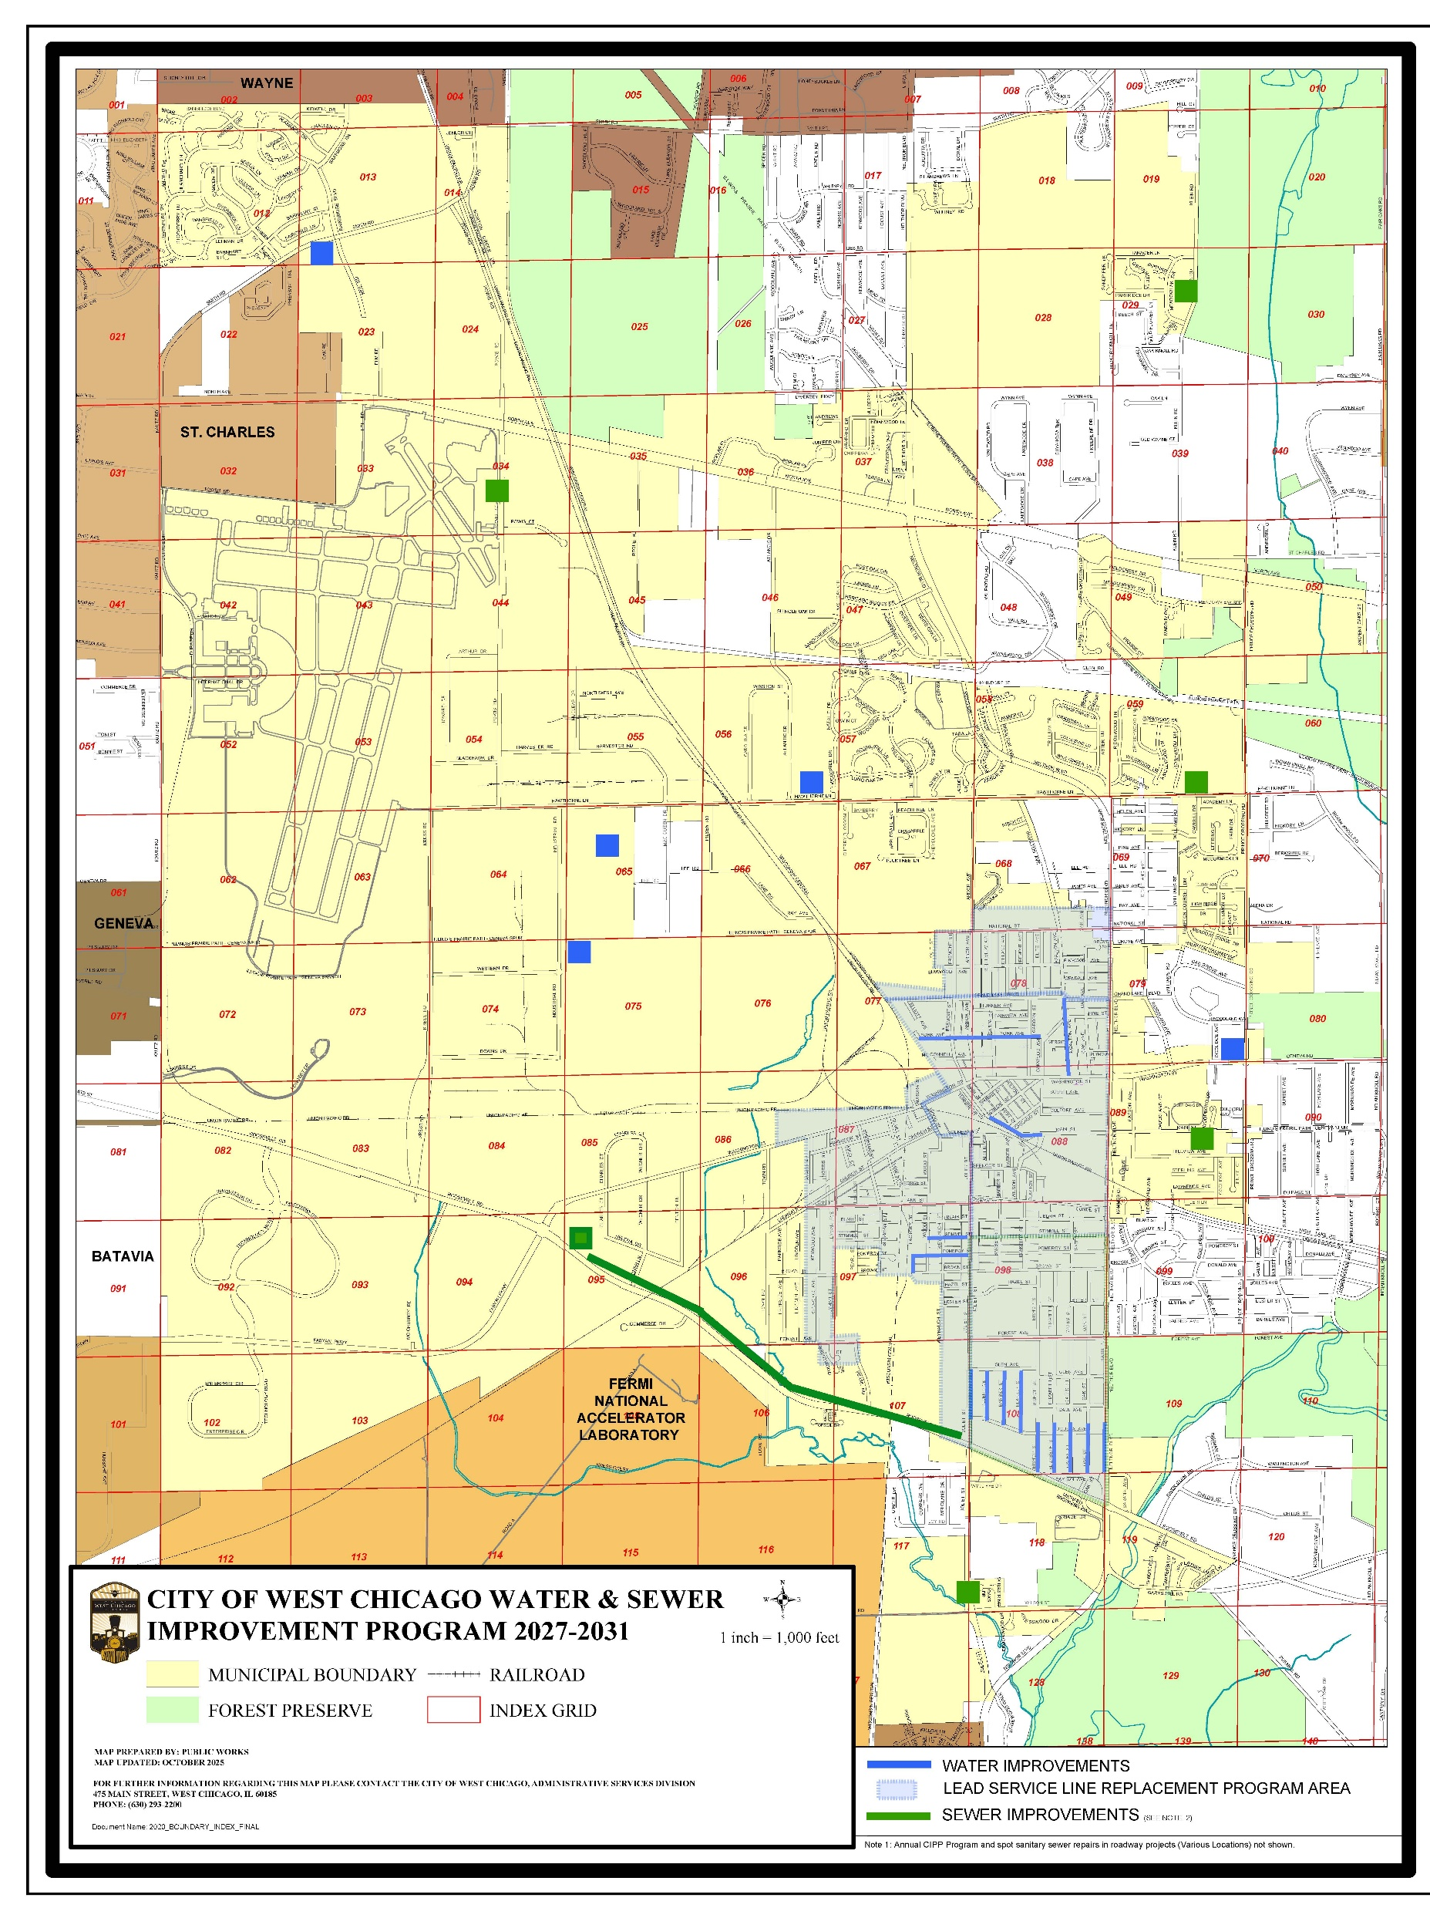
5 YR Water-Sewer Capital Improvement
Program
$2.41 Million – Well Houses
$16.62 Million* – Distribution System
$14.06 Million** - Water Storage
$3.57 Million – Water Treatment Plant
$12.32 Million – Sanitary Collection System
*12.5M - ~797 LSLR
**11.4M - 1.5 MG Elevated Tower

Slide 15
Watermain Break History 2007-2022
70% of the breaks between 2007-2022 occurred on watermains with 50+ years of age
Since October 2022, approximately 125 watermain breaks have occurred (~31/year)
2022 Water Model study recommends City to replace 1.50 miles/year (~8,000 feet) - ~100-year replacement cycle
FY 2027-31, projected replacement is about 0.55 miles/year( ~2,900 feet) - ~267-year replacement cycle

Slide 16
Rate Timeline

Slide 17
West Chicago Historic Rates
Ordinance No. | Date Passed | Date Effective | Water Rate | Sewer (Residential) | Sewer (Commercial)
05-O-0009 | 5/1/2006 | 5/1/2006 | $2.90* ($3.88) | $2.68* ($3.58) | N/A
07-O-0019 | 7/1/2007 | 7/1/2007 | $2.90* ($3.88) | $2.90* ($3.88) | $3.06* ($4.09)
08-O-0006 | 7/1/2008 | 7/1/2008 | $2.90* ($3.88) | $3.50* ($4.68) | $3.66* ($4.89)
 | 7/1/2008 | 7/1/2009 | $2.90* ($3.88) | $4.20* ($5.61) | $4.36* ($5.82)
12-O-0010** | 4/11/2012 | 4/11/2012 | $3.88 | $5.61 | $5.82
19-O-0018 | 5/20/2019 & 5/20/2020*** | 7/1/2022 | $5.00 ($3.88 until 7/1/2022) | $7.00 ($5.61 until 7/1/2022) | $7.30 ($5.82 until 7/1/2022)
22-O-0036 | 12/5/2022 | 7/1/2023 | $9.00 | $10.00 | $10.30
23-O-0025 | 9/5/23 | 1/1/25 | $9.45 | $10.50 | $10.82
23-O-0025 | 9/5/23 | 1/1/26 | $9.90 | $11.00 | $11.34
*rates are per 100 cubic feet . **rates were switched to per 1,000 gallons (100 cubic feet = 748.5 gallons)
***Only rates effective 5/20/2020 were implemented on 7/1/2022 due to the pandemic

Slide 18
Rate Comparison (Avg $10.86/$6.96)
Municipality | Approx. Population | Approx. Area (Square Miles) | Water Rates (1,000 Gallons) | Sewer Rates (1,000 Gallons)
West Chicago | 25,600 | 15 | $9.90 | $11.00
Downers Grove | 49,400 | 15 | $11.24 | $3.65*
Lombard | 43,300 | 10 | $11.40 | $7.74*
Addison | 34,800 | 10 | $11.58 | $8.47
Woodridge | 33,200 | 10 | $11.74 | $6.47*
Elmhurst | 45,000 | 10 | $14.82 | $11.45
Wheaton | 52,300 | 11 | $8.44 | $7.90*
Glen Ellyn | 28,000 | 7 | $10.50 | $7.57*
Westmont | 23,600 | 5 | $12.36 | $3.65*
Lisle | 22,900 | 7 | $8.04 | $6.24*
Villa Park | 21,400 | 5 | $10.54 | $3.85*
Darien | 21,500 | 6 | $9.75 | $5.57*
*served wholly/partially by various sanitary districts

Slide 19
Rate Comparison – Continued ($9.12/$8.38)
Municipality | Approx. Population | Approx. Area (Square Miles) | Water Rates (1,000 Gallons) | Sewer Rates (1,000 Gallons)
West Chicago | 25,600 | 15 | $9.90 | $11.00
Aurora | 175,700 | 45 | $10.29** | $11.07*
Batavia | 26,100 | 11 | $5.79 | $8.66*
St. Charles | 32,400 | 14 | $11.70 | $8.83
Montgomery | 22,900 | 10 | $8.93** | $8.26*
Elgin | 112,400 | 38 | $8.17** | $5.87*
Geneva | 25,900 | 16 | $9.05 | $4.96
*served wholly/partially by various sanitary districts
** lime softening water treatment plant like West Chicago

Slide 20
Rate Comparison

Slide 21
Rate Comparison – Key Takeaways
Similar-sized communities aren't directly comparable
West Chicago is the only DuPage County community with a centralized Water Treatment Plant and a Wastewater Treatment Plant
Most DuPage County communities are served by DuPage Water Commission
    (No Active Wells or WTP)
Many are served by separate Sanitary Districts
    (independent taxing bodies-cost on property tax bill)
Rates should be based on infrastructure maintained locally, not population
A water/sewer rate study is underway

Slide 22
Pre-planned Rate Schedule
Ordinance No. | Date Passed | Date Effective | Water Rate | Sewer (Residential) | Sewer (Commercial)
23-O-0025 | 9/5/23 | 1/1/26 | $9.90 | $11.00 | $11.34
 | 9/5/23 | 1/1/27 | $10.40 | $11.50 | $11.86
 | 9/5/23 | 1/1/28 | $11.00 | $12.15 | $12.53
Average Bi-Monthly Residential Water & Sewer Bill (15,000 gallons usage, ¾" meter)
 | 2025 | 2026 | 2027 | 2028
Water | $148.21 | $153.84 | $160.09 | $167.60
Sewer | $161.50 | $169.00 | $176.50 | $186.25
Total | $309.71 | $322.84 | $336.59 | $353.85

Slide 23
Status of the Rate Study & Staff Recommendation
Contract executed on May 18, 2026
Project kickoff meeting held on June 18, 2026
Interactive meetings held on August 12 and October 8 – Reviewed current infrastructure water and sewer systems; current and proposed 5-year CIP; inflation assumptions; funding alternatives; financial modeling and long-term planning including but not limited to water meter replacement, emergency connections, declining demand, watermain replacement program, wastewater treatment, lift station consolidation, etc.
Expected to be completed in Early 2027.
Staff recommendation is to continue with pre-planned rate increase in 2027.

Slide 24
Questions?
Seeking Direction if Different than proposed

